Slide 1

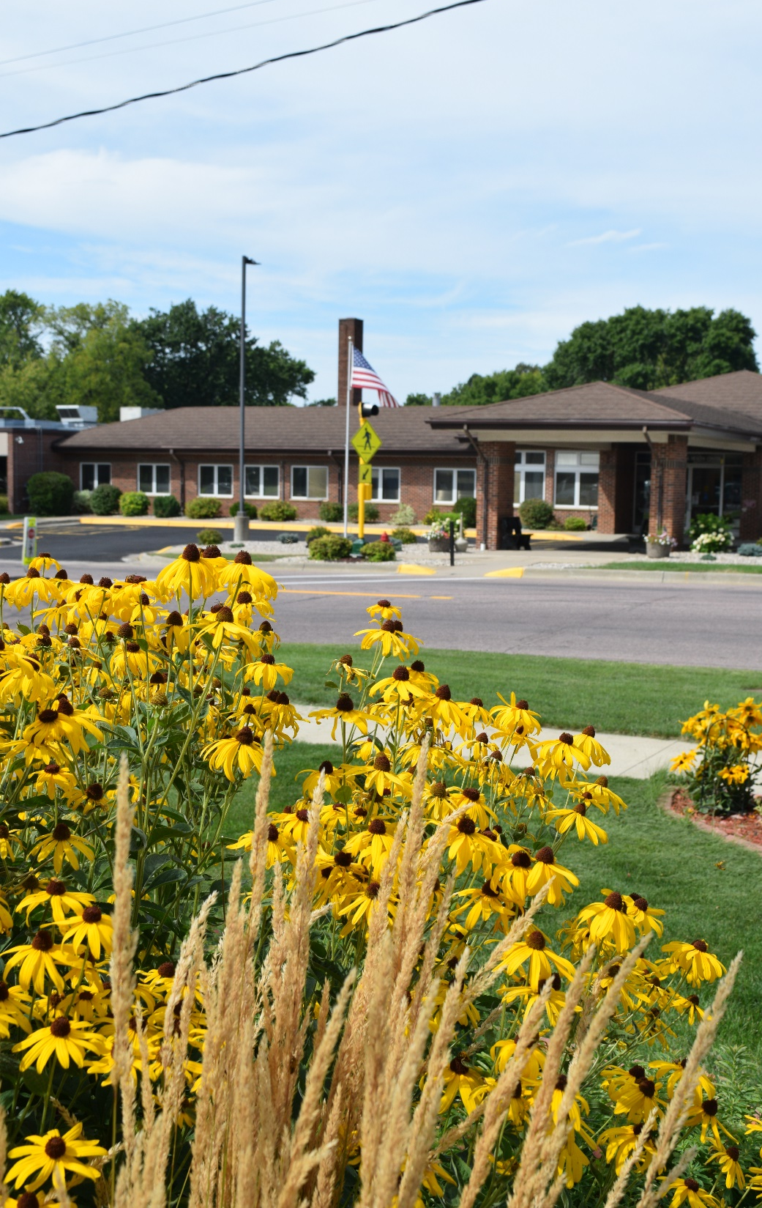

Community Health Needs Assessment
May 2025

Slide 2
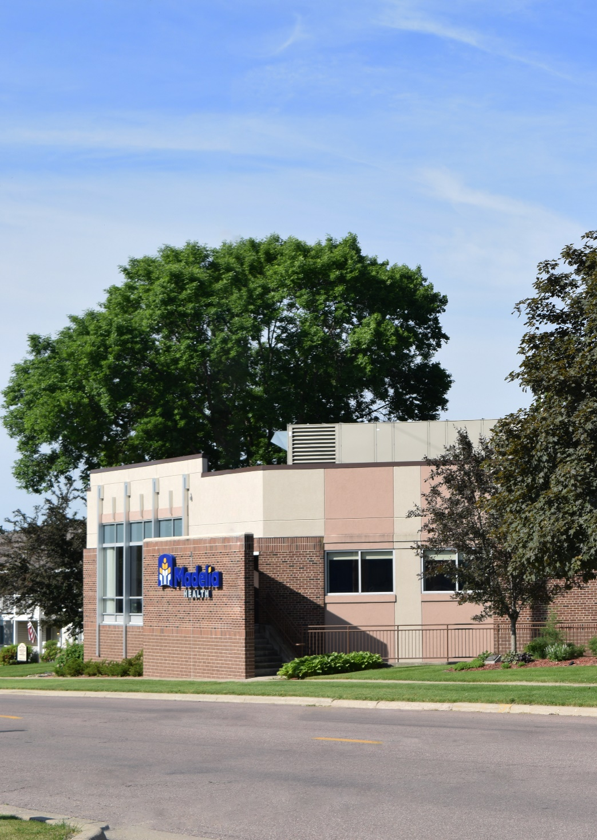

Contents
CHNA Overview
Organization Overview
Community Served
Health Data
County Health Rankings
Community Focus Group
Community Survey
Prioritization of Needs
Impact of Prior CHNA
Next Steps

Slide 3

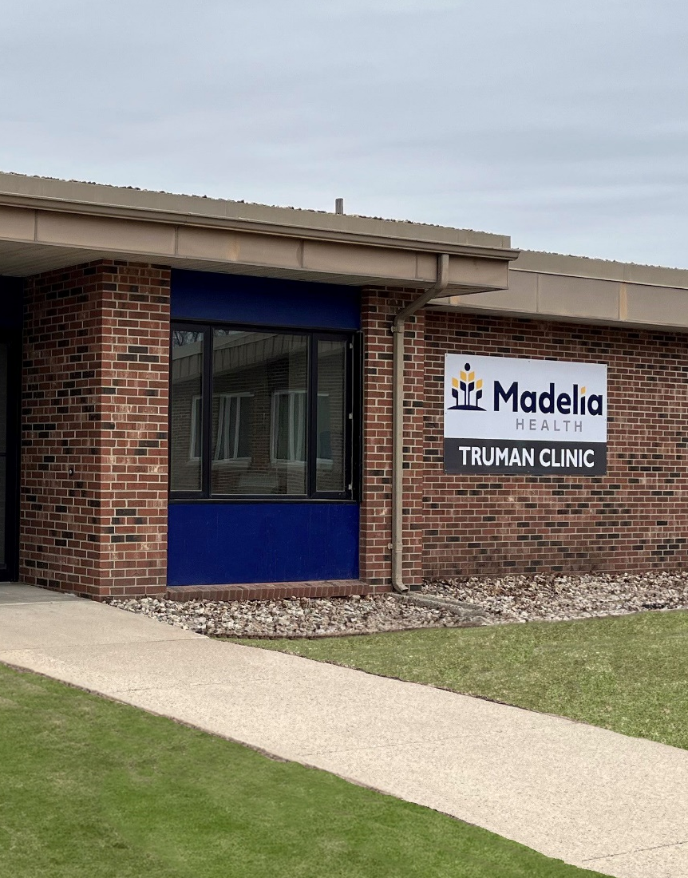
Overview
In the spring of 2025, Madelia Health conducted a Community Health Needs Assessment (CHNA) for the residents (approximately 16,000) of its community.
A CHNA is a tool used to help communities assess their strengths and weaknesses when it comes to the health of the community. It is also the foundation for improving and promoting community health.
The process helps identify factors that affect a population’s health and determines the availability of resources within the community to adequately address these factors and any additional health needs.
Madelia Health 2025 Community Health Needs Assessment

Slide 4
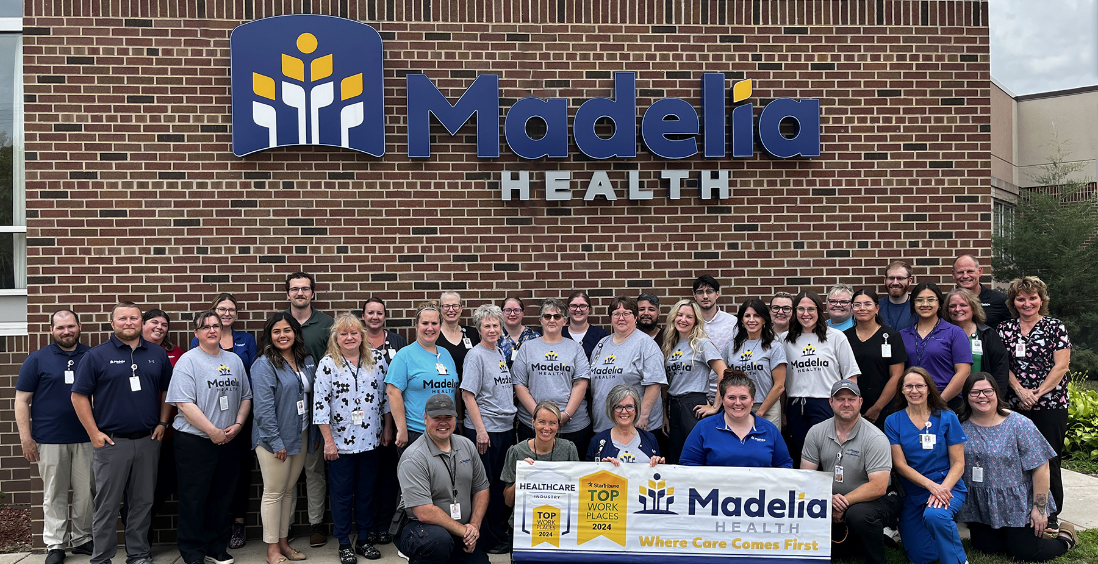
Overview
The CHNA process fulfills the requirements set forth by Internal Revenue Code 501(r)(3), a statute established within the Patient Protection and Affordable Care Act, which requires not-for-profit hospitals to conduct a CHNA every three years. This report includes qualitative and quantitative information from local, state, and federal sources. In addition, input was received from persons that represented a broad range of interests in the community, persons with public health knowledge and expertise, and persons representing medically underserved and vulnerable populations.
Madelia Health 2025 Community Health Needs Assessment

Slide 5
Organization Overview
Madelia Health is an independent, non-profit health system located in Watonwan County and provides services to surrounding rural communities in Southern Minnesota. Madelia, MN is home to its hospital, including 24-hour emergency department. Additional locations include the Lake Crystal Clinic, Truman Clinic, and St. James Clinic.
Madelia Health offers inpatient, outpatient, and 24-hour emergency care services with comprehensive medical, surgical, radiological, advanced clinical testing, and therapy capabilities. It is accredited by the Joint Commission and is a federally designated critical access hospital.
Madelia Health utilizes a “wellness environment” room design to aid the healing and recovery of the patient as well as increase the efficiency and lessen the fatigue of medical staff members. Partnerships with other regional clinics and hospitals provide a full spectrum of health services, including helicopter transfer capability.
The provider-based clinics offers complete family care and includes Spanish-speaking providers. Services include urgent care, disease management, preventive medicine, injury and illness care, pediatrics, and prenatal care, primarily serving a 30-mile radius.
Madelia Health 2025 Community Health Needs Assessment

Slide 6
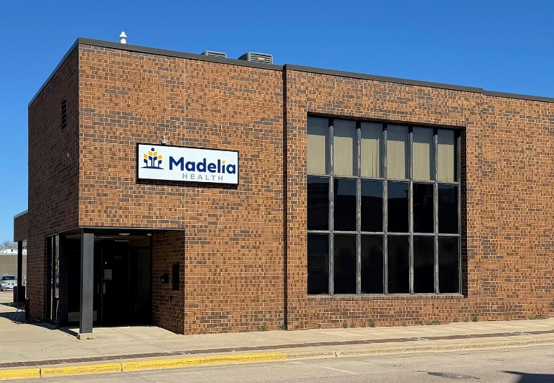
Organization Overview
Madelia Health’s services include:
Ambulance
Advanced Clinical Testing
Clinic
  Disease Management
  Preventive Medicine
  Illness & Injury Care
  Pediatrics
  Mental Health
  Veteran Services
  Telehealth
Emergency Room
Laboratory
Pain Management
Physical & Occupational Therapy
Radiology
Surgery
Swing Bed
Podiatry & Wound Care
Ear, Nose & Throat
Dermatology
Madelia Health 2025 Community Health Needs Assessment

Slide 7
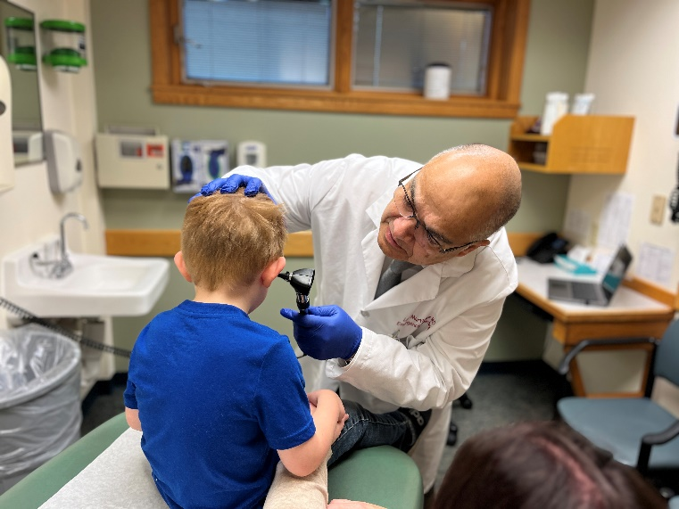
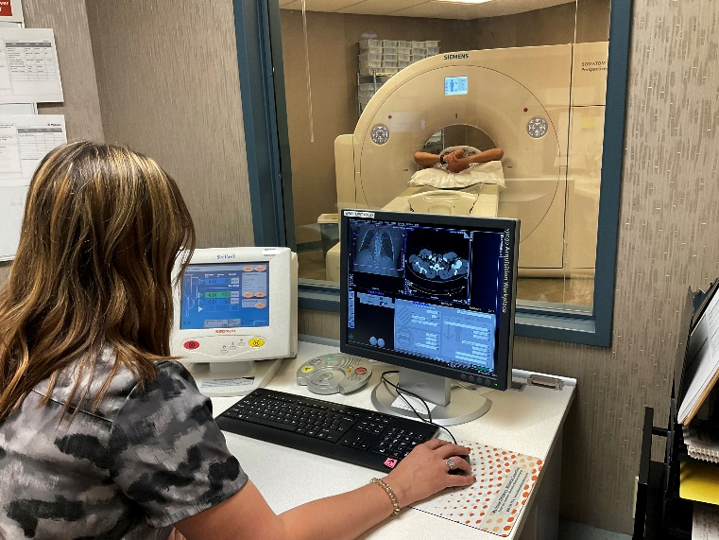
Organization Overview
Madelia Health and its 170+ employees are dedicated to providing patient-centered health care with excellence in quality, service, and access.
Vision:
To be the premiere rural health system in Southern Minnesota.
Values:
Inclusive
Progressive
Integrity
Compassion
Entrepreneurship
Madelia Health 2025 Community Health Needs Assessment

Slide 8
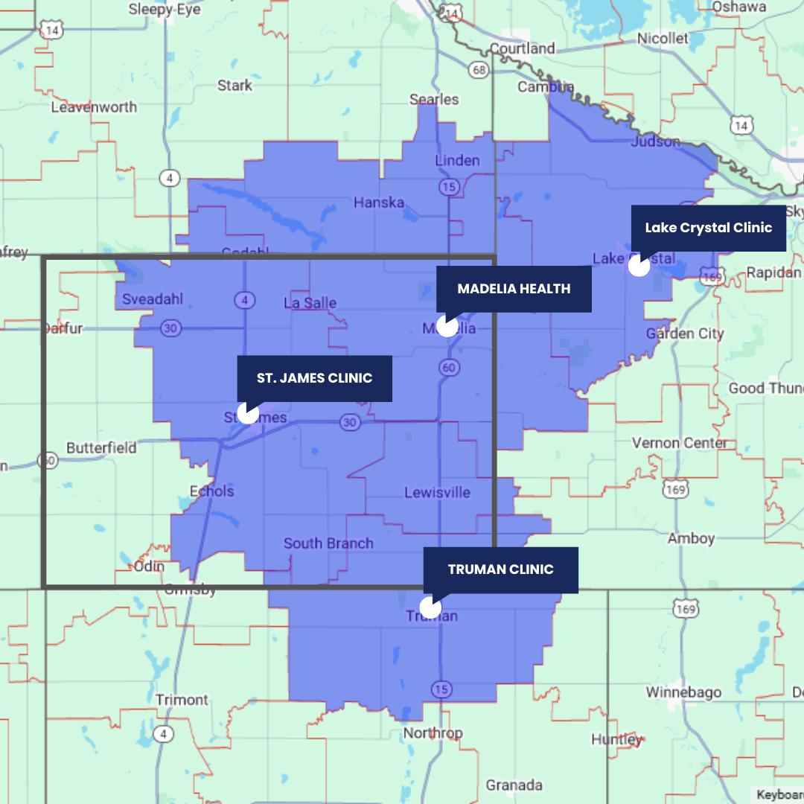
Community Served
For this needs assessment, “community” is defined as the residents of six Minnesota zip codes, noted in blue on the map (56055, 56041, 56062, 56081, 56060, and 56088). All residents of this region are considered members of the community, including low-income, medically underserved, and all races and ethnicities, regardless of ability to pay and/or whether they are eligible for financial assistance.
The boundary of Watonwan County is demarcated by the thick gray line. Madelia Health’s locations are noted with white dots.
This region was identified as the “community” due to the presence and locations of Madelia Health’s hospital and clinics as well as this being the region where most of Madelia Health’s patients reside.
Madelia Health 2025 Community Health Needs Assessment

Slide 9
Community Served
The community population increased overall from 2020 – 2023, with a 5.42% increase in the 65+ community population. Population trends can indicate the need for more or less health care services in the future. An aging population can impact need for health services, swing bed utilization, senior living, payer mix, etc.
Total Population | 2020 | 2021 | 2022 | 2023 | % Change (2020 – 2025)
Community | 16,458 | 16,929 | 16,762 | 16,764 | 1.83%
Minnesota | 5,600,166 | 5,670,472 | 5,695,292 | 5,713,716 | 2.02%
United States | 326,569,308 | 329,725,481 | 331,097,593 | 332,387,540 | 1.75%
65+ Population | 2020 | 2021 | 2022 | 2023 | % Change (2020 – 2025)
Community | 3,121 | 3,298 | 3,243 | 3,300 | 5.42%
Minnesota | 887,576 | 901,517 | 939,396 | 962,143 | 7.75%
United States | 52,362,817 | 52,888,621 | 54,737,648 | 55,970,047 | 6.44%
Source: United States Census Bureau, ACS 5-Year Estimate Subject Tables
Madelia Health 2025 Community Health Needs Assessment

Slide 10
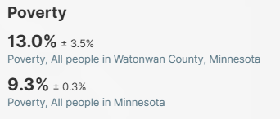
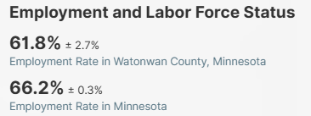
Community Served
The poverty rate for Watonwan County is higher than the rate for the State of Minnesota. 2023 American Community Survey 5-Year estimates showed a median household income in Watonwan County of $70,593, which is lower than Minnesota’s median household income of $85,086.
The unemployment rate for Watonwan County peaked in 2022 at 5.8% and then declined to 5% in 2023. Unemployment rates for the state of Minnesota and the United States peaked in 2021 and were lower than the rates for Watonwan County.
Income can impact housing, food, childcare, stress, alcohol and tobacco use. Income also impacts utilization of preventive care services. This can increase the risk of health problems developing or worsening over time.
Source: 2023 American Community Survey 5-Year Estimates
Source: 2023 American Community Survey 5-Year Estimates
Source: United States Census Bureau, ACS 5-Year Estimate Subject Tables, Population 20-64 Years Unemployment Rate Estimates
Madelia Health 2025 Community Health Needs Assessment

Slide 11
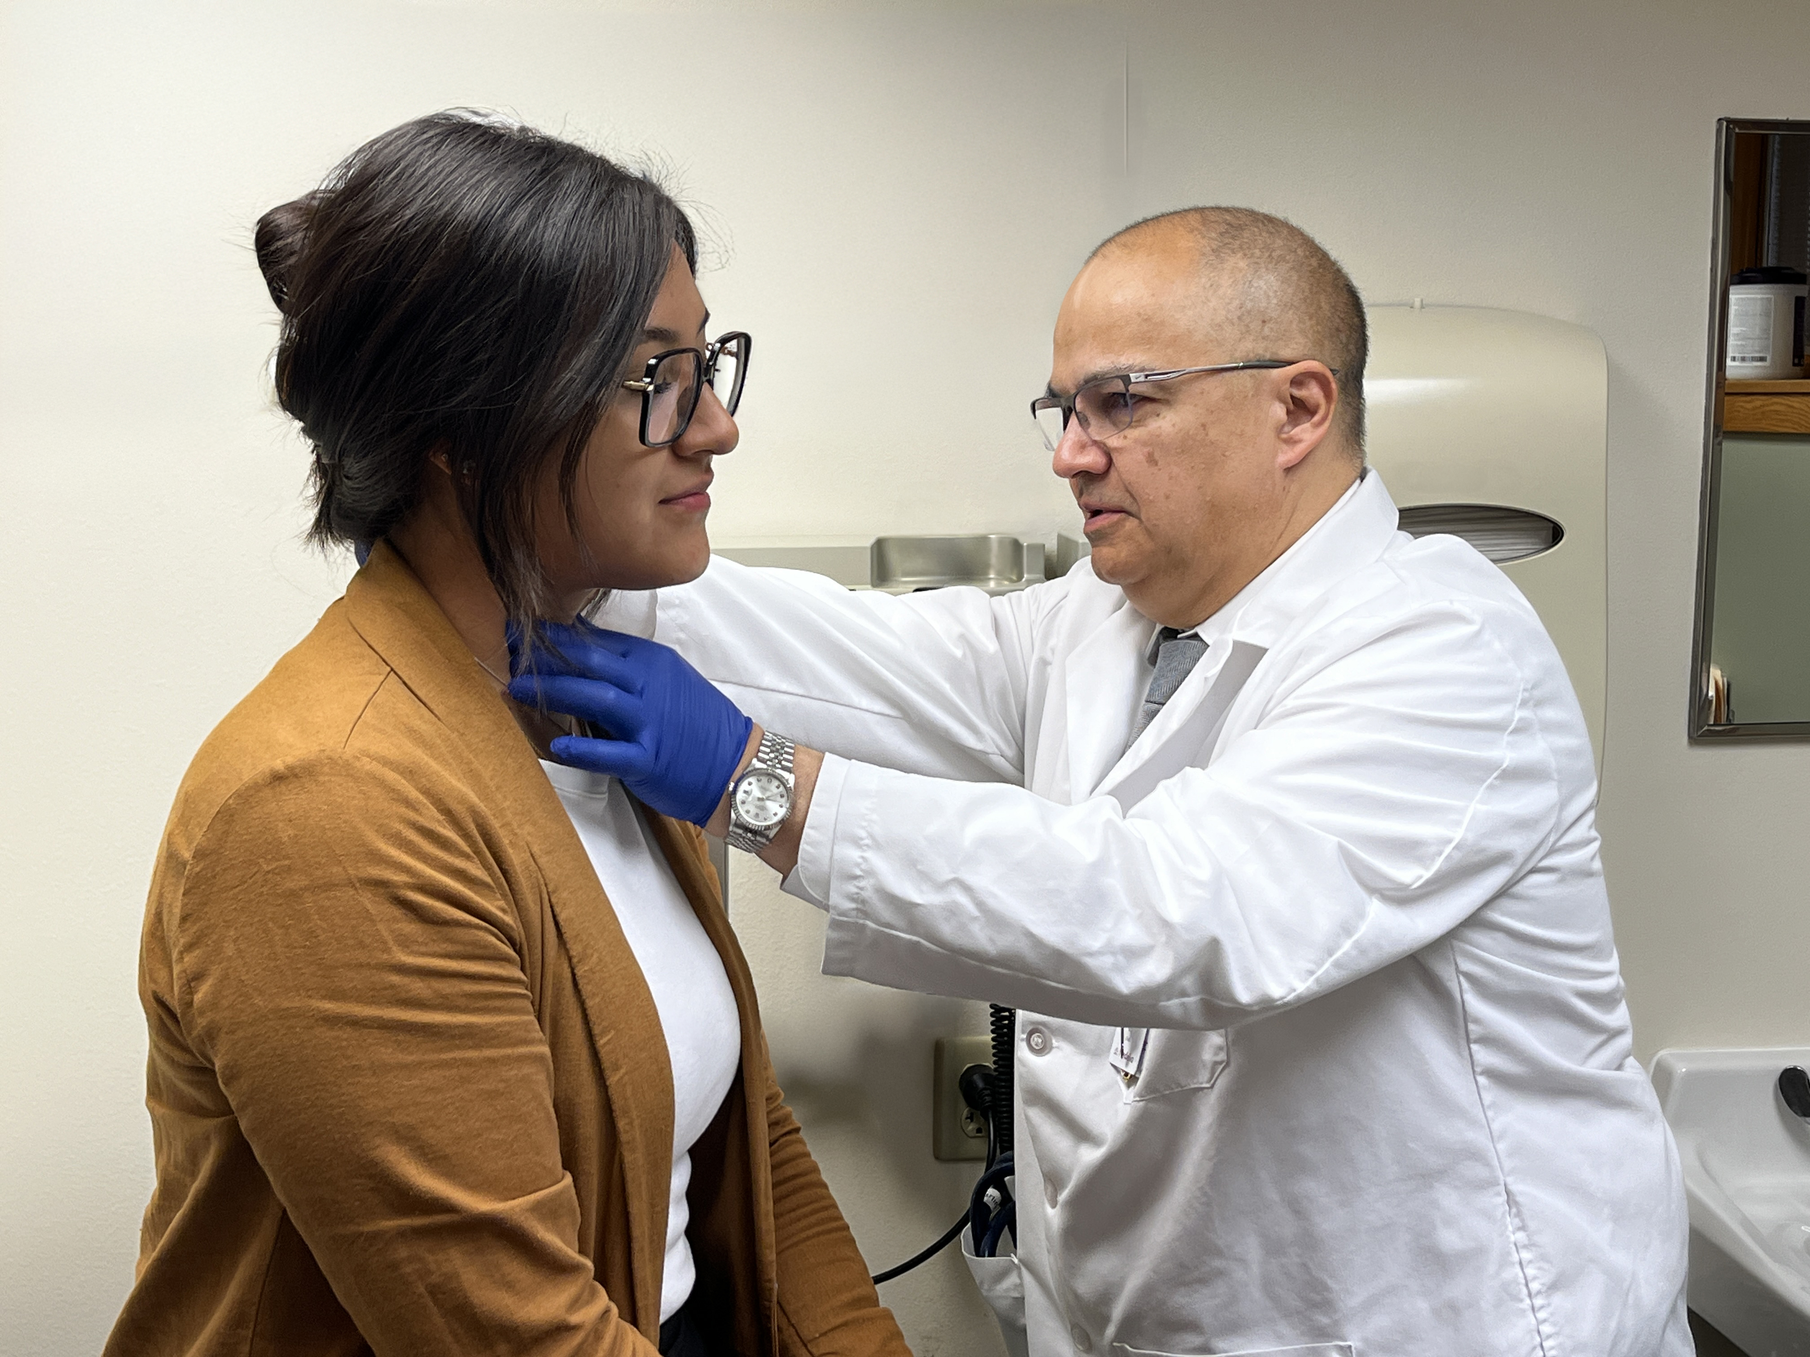
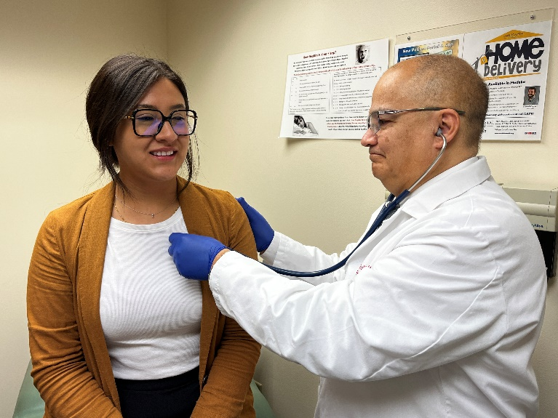
Health Data
To examine health areas of strength and health areas to explore, County Health Rankings is utilized. The County Health Rankings & Roadmaps program is a collaboration between the Robert Wood Johnson Foundation and the University of Wisconsin Population Health Institute. Counties are ranked against their state peers based on health outcomes and health factors. Subcategories are as follows:
The report provides information by county on “Areas of Strength” and “Areas to Explore”, as determined by the County Health Rankings. This can be helpful in setting a direction for the community health needs assessment.
Health Outcomes
Length of life
Quality of life
Health Factors
Health behaviors
Clinical care
Social and economic factors
Physical environment
Source: County Health Rankings, University of Wisconsin Population Health Institute
Madelia Health 2025 Community Health Needs Assessment

Slide 12
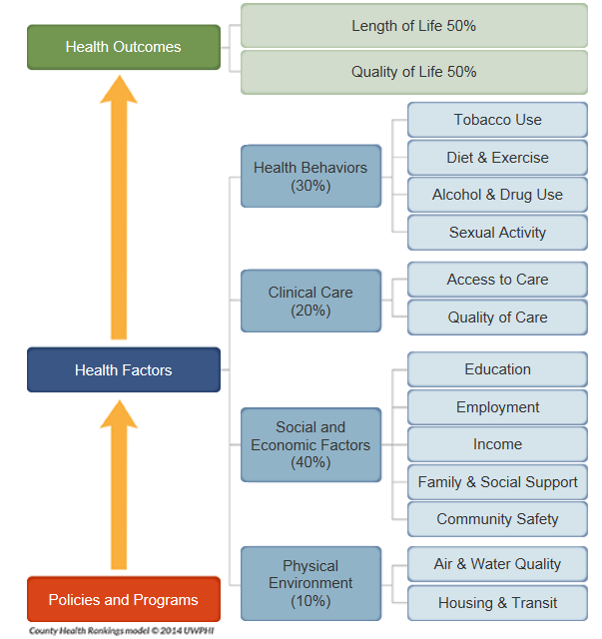

County Health Rankings
The County Health Rankings are based on a model of community health that emphasizes the many factors that influence how long and how well we live.
The Rankings use more than 30 measures that help communities understand how healthy their residents are today (health outcomes) and what will impact their health in the future (health factors).
Source: County Health Rankings, University of Wisconsin Population Health Institute
Madelia Health 2025 Community Health Needs Assessment

Slide 13
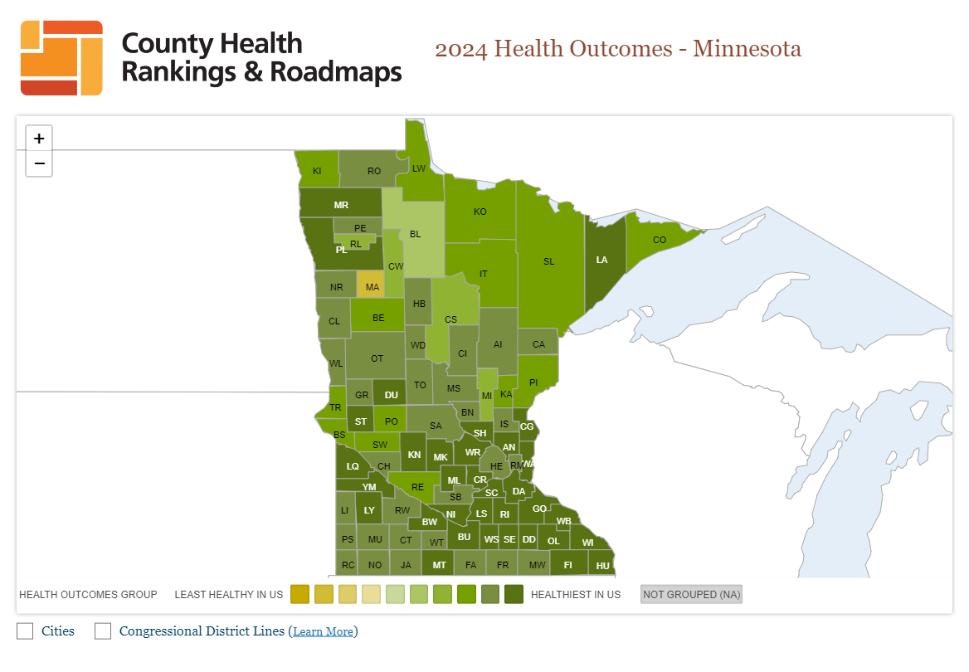
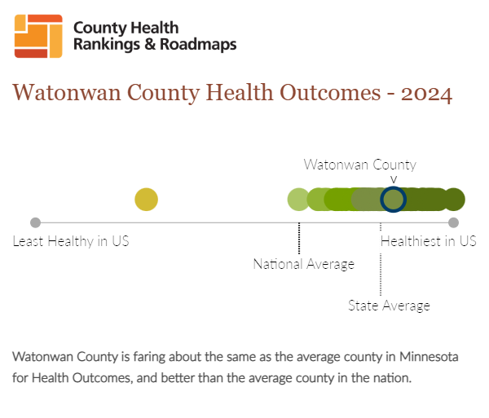
Health Outcomes
This map shows the County Health Rankings assessment of health outcomes for Minnesota in 2024. Watonwan county is outlined in blue. Lower scores indicate better health.
Source: County Health Rankings, University of Wisconsin Population Health Institute
Madelia Health 2025 Community Health Needs Assessment

Slide 14
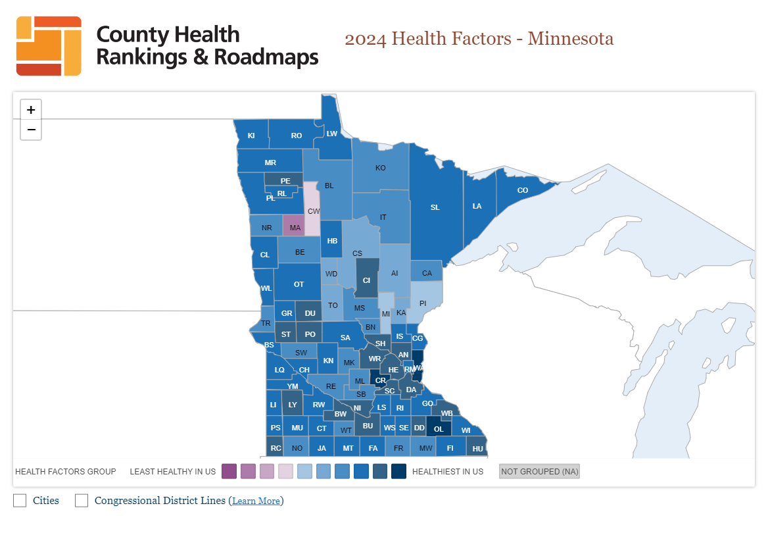
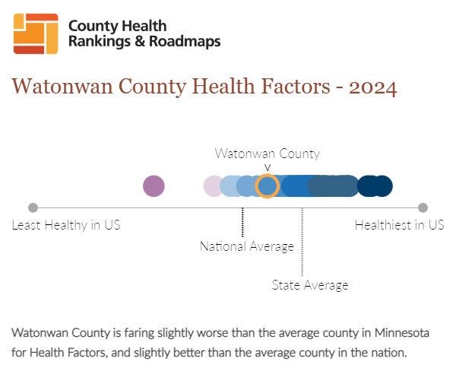
Health Factors
This map shows the County Health Rankings assessment of health factors for Minnesota in 2024. Watonwan county is outlined in yellow. Lower scores indicate better health.
Source: County Health Rankings, University of Wisconsin Population Health Institute
Madelia Health 2025 Community Health Needs Assessment

Slide 15
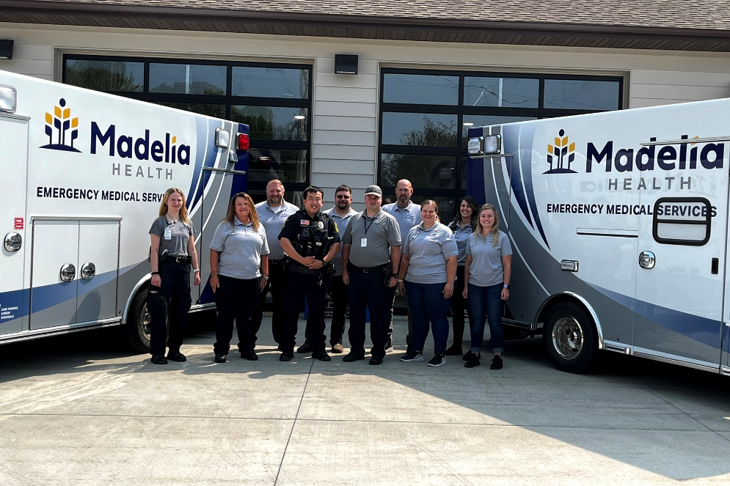
Health Data Results
County Health Rankings uses a variety of techniques to identify the health factors by county that have the greatest potential opportunity for improvement, or assets a community may want to build on while also accounting for the relative influence of each measure on health outcomes. They identify measures where there are meaningful differences between a county’s values and either state average, the national average, or the state average in the best state.
Watonwan County Data:
Areas of Strength
Preventable Hospital Stays
Mammography Screening
Social Associations
Areas to Explore
Adult Smoking
Adult Obesity
Alcohol-Impaired Driving Deaths
Children in Poverty
Source: County Health Rankings, University of Wisconsin Population Health Institute
Madelia Health 2025 Community Health Needs Assessment

Slide 16
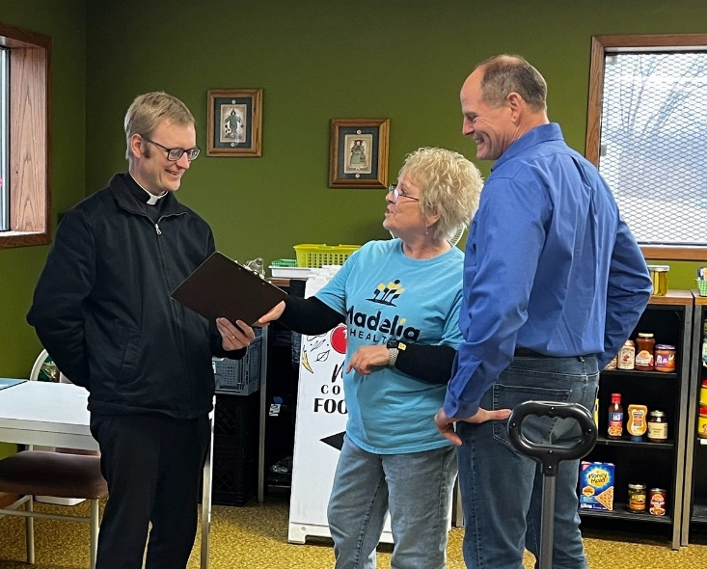
Community Focus Group
Three focus groups were held with community stakeholders to facilitate discussion and get input around the health needs and resources in the community, with one focus group facilitated in Spanish. Two focus groups were held on February 17th, 2025, and an additional focus group was held on February 20th, 2025.
Organizations represented are as follows:
Madelia Health – Primary Care & Mental Health
City of Madelia – Housing & Development
Madelia City Council – Environmental Advocacy
St. Mary Catholic School – Education
Citizens Bank Minnesota – Agriculture
Trinity Lutheran – Spiritual Communities
High Step* – Youth
Community Options & Resources – Vulnerable Populations
Living Meadows Social Services – Older Adults
Watonwan County Public Health – Public Health
Madelia Food Shelf – Volunteer Organizations
Madelia High School – Education
Organizations invited but could not attend: Alternative Roots, Madelia Elementary, Downs Food, Madelia Chamber, Moody Bees, Madelia Times Messenger, Mayor of Madelia, and the Madelia Police Department.
*After recognizing that youth voices were missing from the three focus groups, we sent a survey to High Step, which encompasses high school students interested in healthcare careers.
Madelia Health 2025 Community Health Needs Assessment

Slide 17
Community Focus Group
The following summarizes feedback gathered from all three CHNA focus groups, outlined in the following areas: healthy communities, community strengths, health challenges, access to care, community resources, quality of life, social determinants of health, and recommendations.
Characteristics of Healthy Communities
Medical access to a hospital or clinic
Volunteer groups
Healthy food options
Safe and affordable housing
Home care
Sense of belonging
Transportation
Options for fitness and social activities
Healthy environment, including parks
Mental health resources
Community Strengths
Vibrant hospital and clinic
Mental health resources
Outdoor spaces and parks
Care for vulnerable communities (continuity of care)
Resources for food insecurity
Community walkability and safety
Awareness of health services
Same day appointments
Strong support systems of people willing to help
Access to specialty providers and referrals when needed
Access to Care (Barriers)
Mental health resources in schools
Environmental work
Transportation
Language
Uninsured
Immigration concerns
Health Challenges
Home health care and assisted living
Restrictions and regulations
Resources for poor and elderly populations
Isolation, lack of sense of belonging
Volunteerism
More places for youth to spend time (ex: Rec. Center)
Madelia Health 2025 Community Health Needs Assessment

Slide 18
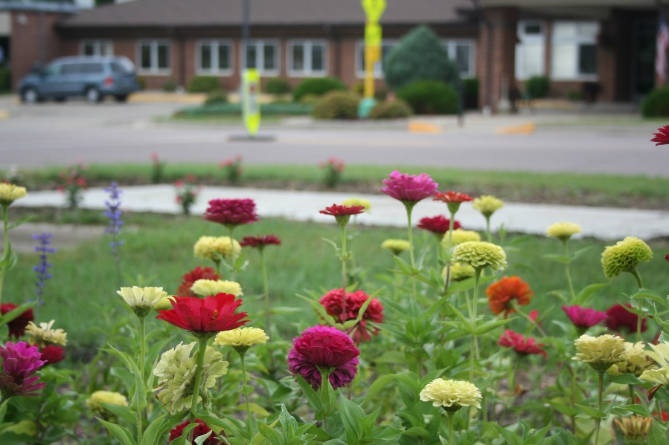
Community Focus Group
Community Resources
Fitness center (affordability)
Grocery store
Food shelf
Backpack Food Program (Highschool)
MCBC events at elementary school
Need for better nutrition and life-skill education (ex: home economics)
Social Determinants of Health
Poverty
Lack of transportation
Language and reading barriers
Missing work for preventative health
Solutions & Improvements
Community coming together
Increased collaboration
Places for youth to spend time, along with more youth activities.
Quality of Life
Strengths
Good place to raise children
Safe community
Ample economic opportunity
Strong networks to support individuals and families.
Areas to Improve
Some elderly isolated
Seeking more community involvement from younger generations
Not all residents feel they can make the community a better place to live
Madelia Health 2025 Community Health Needs Assessment

Slide 19
Prioritization of Needs
The core CHNA work group was comprised of the following staff:
Director of Clinical Quality, Outcomes, & Compliance
Clinical Quality Outcomes Specialist
Chief Clinical Officer
Marketing & Business Development Specialist
This group met to review the needs identified through the community health needs assessment process. After analyzing input from the focus groups, survey, and community health data, they did a preliminary prioritization that identified needs based on potential impact on community health, the urgency of the need, and the ability to meet these needs. The following health areas are determined to be prioritized in no particular order:
Obesity – Nutrition & Fitness (including the exploration of affordable options).
Community Collaboration – Quarterly Roundtables (held prior to city council meetings).
  Develop an implementation for the CHNA.
  Address transportation concerns.
  Other priorities as identified by participants over the next three-year cycle.
Mental Health – Addressing social isolation by providing resources for the poor and elderly.
Some health issues or needs that were identified through the CHNA process are not prioritized at this time due to being outside the scope/abilities of Madelia Health and/or the issue is being addressed by other community resources or organizations. In other instances, there are already initiatives in place at Madelia Health to address some needs. Madelia Health is not ignoring these issues but intends to collaborate (within its ability) with other organizations to address and make progress.
Madelia Health 2025 Community Health Needs Assessment

Slide 20
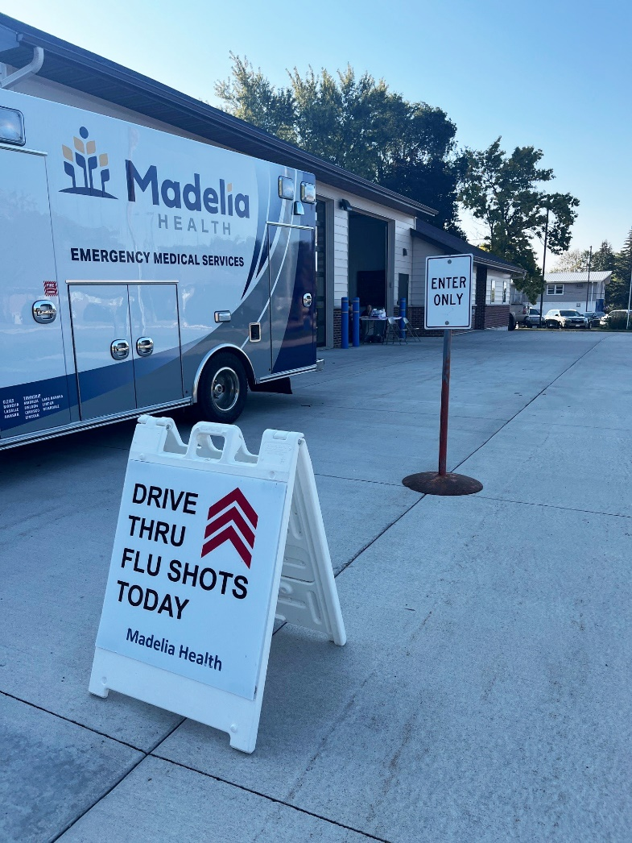
Community Resources
In addition to Madelia Health, the following organizations provide health and health-related services in and around Watonwan County:
Madelia Health EMS
Lewis Family Drug
Madelia Health Independent Living
Madelia Enterprises
Apple Tree Dental
Madelia Optometric
Madelia Chiropractic Office
Madelia Community Based Collaborative
Mayo Clinic Health Systems – St. James
Stepping Stones Mental Health Center
REM Heartland
Watonwan County Veterans Service Office Community Options and Resources (COR)
Madelia Health 2025 Community Health Needs Assessment

Slide 21
Evaluation of Impact of Prior CHNA
Madelia Health completed a Community Health Needs Assessment in 2022. No written comments have been received from this assessment. Madelia Health prioritized the following needs during this assessment and have conducted the following activities in order to address the needs identified:
Mental & Behavioral Health
Hired additional mental health staff including a psychiatric & mental health nurse practitioner and a licensed marriage & family therapist with special interest in children.
Remodeled space in the lower level of the Madelia Health main campus to create a mental health clinic.
Senior Leadership approved training for an RN interested in specializing as a psychiatric and mental health nurse.
Madelia Health EMS made pizza deliveries with the ambulance and provided educational material on recognizing mental health symptoms and where to find help.
Continued partnership with Madelia Community Based Collaborative (MCBC)
  Annual Coloring Contests in the Elementary School – Students were read a book and then asked to create a poster on what they learned. Topic was social networks for positive mental health.
Obesity & Nutrition
  Madelia Health continued its partnership with MCBC to educate children in healthy habits programs.
  Annual Try It Fridays – Madelia Health representative led this activity with the children in Madelia Elementary. Each Friday for 5 weeks, they were asked to try one vegetable and one fruit they may have never tried. This has been a big hit with the kids. They are excited to try the new fruits and vegetables and look forward to Michael coming.
  Annual Coloring Contests in the Elementary School – Students were read a book and then asked to create a poster on what they learned. The topics were Rest to ReCharge and ReThink Your Drink
Stroke Awareness & Prevention
  Provided low-cost Annual Stroke Screenings.
  Madelia Health EMS made pizza deliveries with the ambulance and provided stroke awareness & prevention materials.
Madelia Health 2025 Community Health Needs Assessment

Slide 22
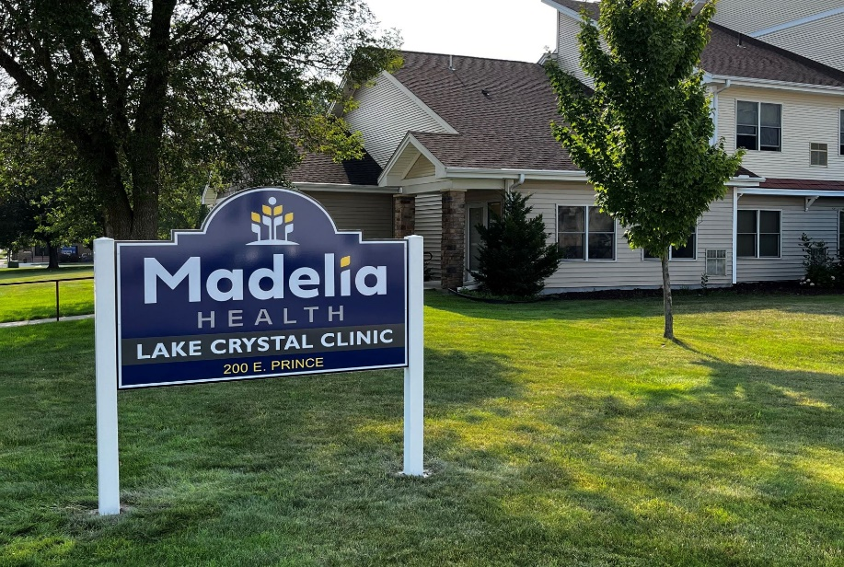
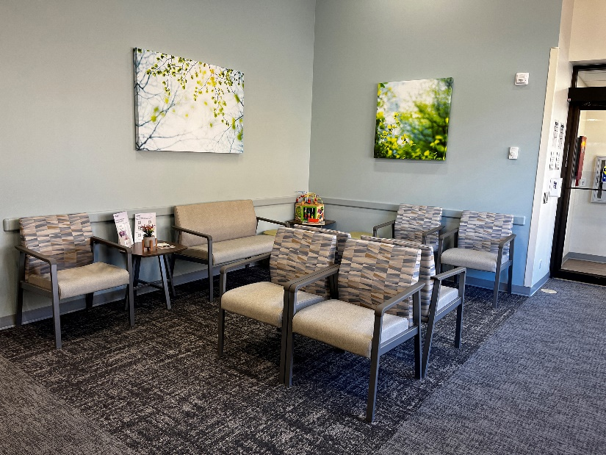
Next Steps
This Community Health Needs Assessment report was approved by the Madelia Health Board of Directors on May 15th, 2025.
Madelia Health is required to adopt an organization-specific implementation strategy in response to the Community Health Needs Assessment report. This will be completed, approved by the board, and made available to the public by November 15th, 2025. The implementation strategy will be reviewed on an annual (or more frequent) basis. The CHNA process, public report, and implementation strategy will be repeated every three years, as required by Internal Revenue Code 501(r)(3).
Madelia Health 2025 Community Health Needs Assessment

Slide 23
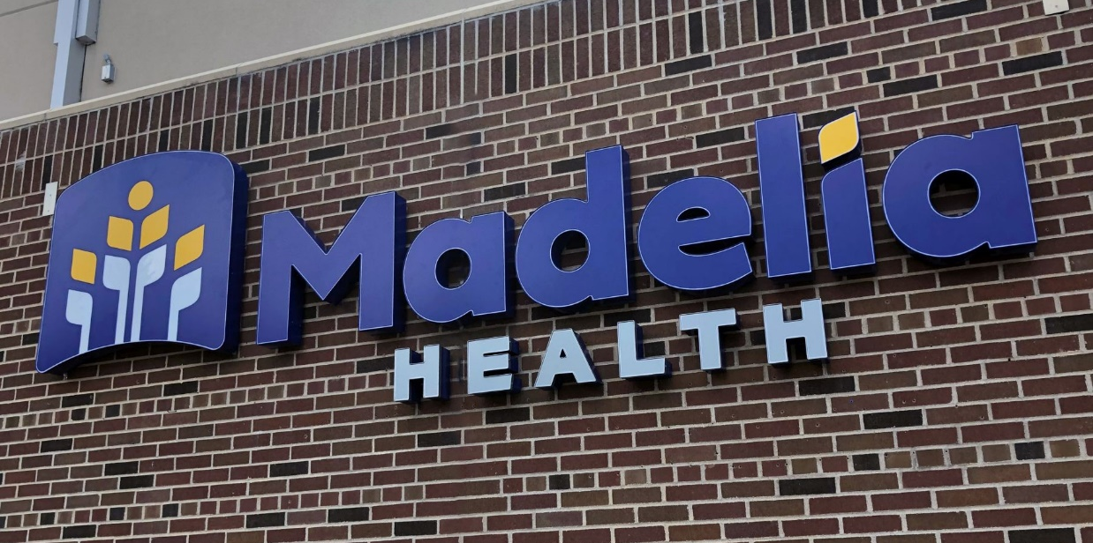
Contact Information
Community members who would like to provide comments on the needs identified or provide input on the next CHNA process are encouraged to contact Madelia Health with their inquiries, suggestions or comments.
      Jodi Ulmen
Director of Clinical Quality, Outcomes & Compliance
      Madelia Health
      121 Drew Avenue SE
      Madelia, MN 56062
      julmen@madeliahealth.org
Madelia Health 2025 Community Health Needs Assessment

